Slide 1
Portable biometrics for determining cognitive load from galvanic skin response
Guido Zuidhof
December 2014

Slide 2
Cognitive load measurement
Many approaches to measuring cognitive load
R. Brünken et al. (2003), Direct Measurement of Cognitive Load in Multimedia Learning. Educational Psychologist 38(1), 53-61
 | Indirect | Direct
Subjective | Self-reported invested mental effort | Self-reported stress level Self-reported difficulty of materials
Objective | Psysiological measures Learning outcome measures | Brain activity measures (e.g. fMRI) Dual-task performance

Slide 3
Cognitive load measurement
In my thesis we are focusing on psychological measures
 | Indirect | Direct
Subjective | Self-reported invested mental effort | Self-reported stress level Self-reported difficulty of materials
Objective | Psysiological measures Learning outcome measures | Brain activity measures (e.g. fMRI) Dual-task performance

Slide 4
Psychiological response
The body displays a response under an increased cognitive load
Many different options for measuring

Slide 5
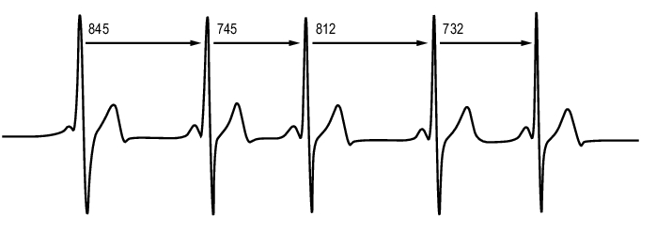
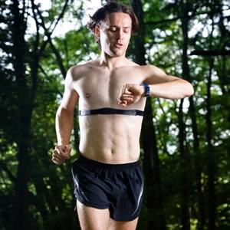
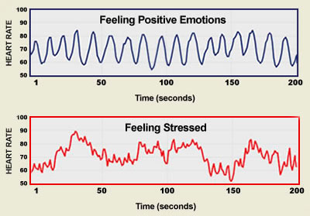
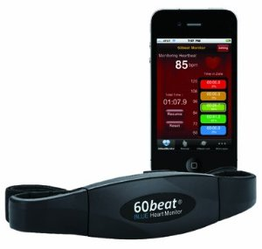
Heart rate variability (HRV)
Time between heart beats

Slide 6
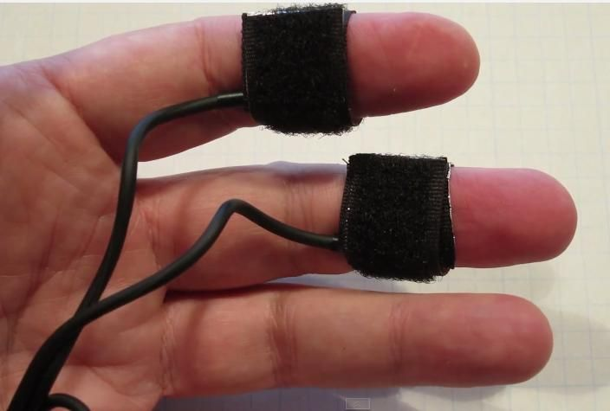
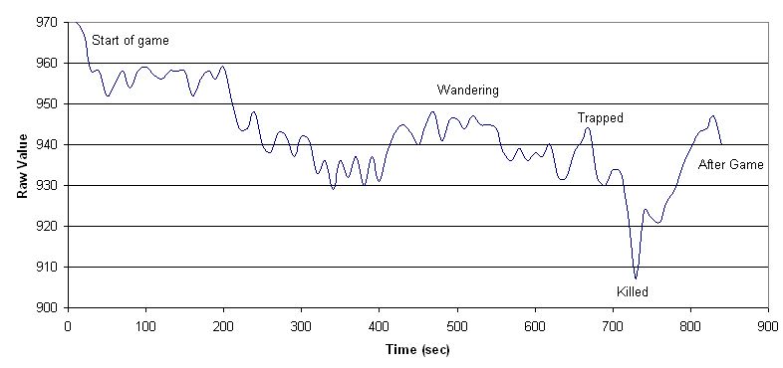
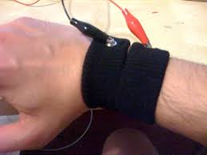
Galvanic Skin Response (GSR)
Or Electrodermal Response (EDR), Skin Conductance Response (SCR)
Measuring the electrical conductance of skin
Gets influenced by sweat and openness pores

Slide 7
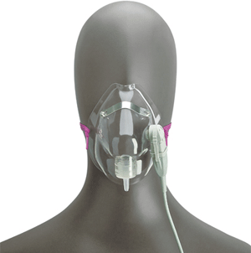
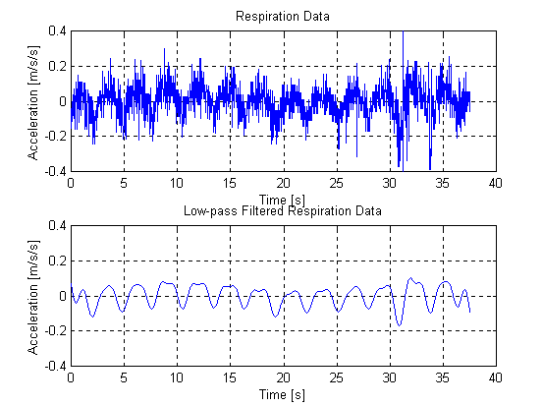
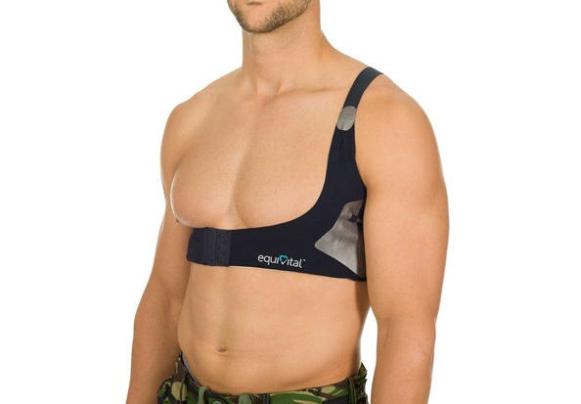
Respiratory rate
Or Ventilatory rate, Breathing frequency

Slide 8
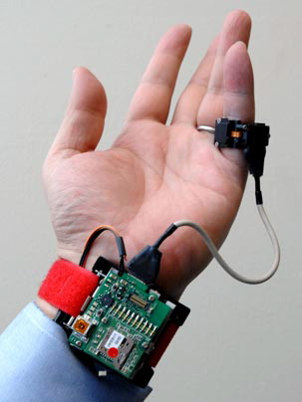
Other psysiological responses
Blood oxygen level
Skin temperature / heat flux
Blood pressure
Motion (measured using accelerometer)
...
One generally does not exclude the others

Slide 9
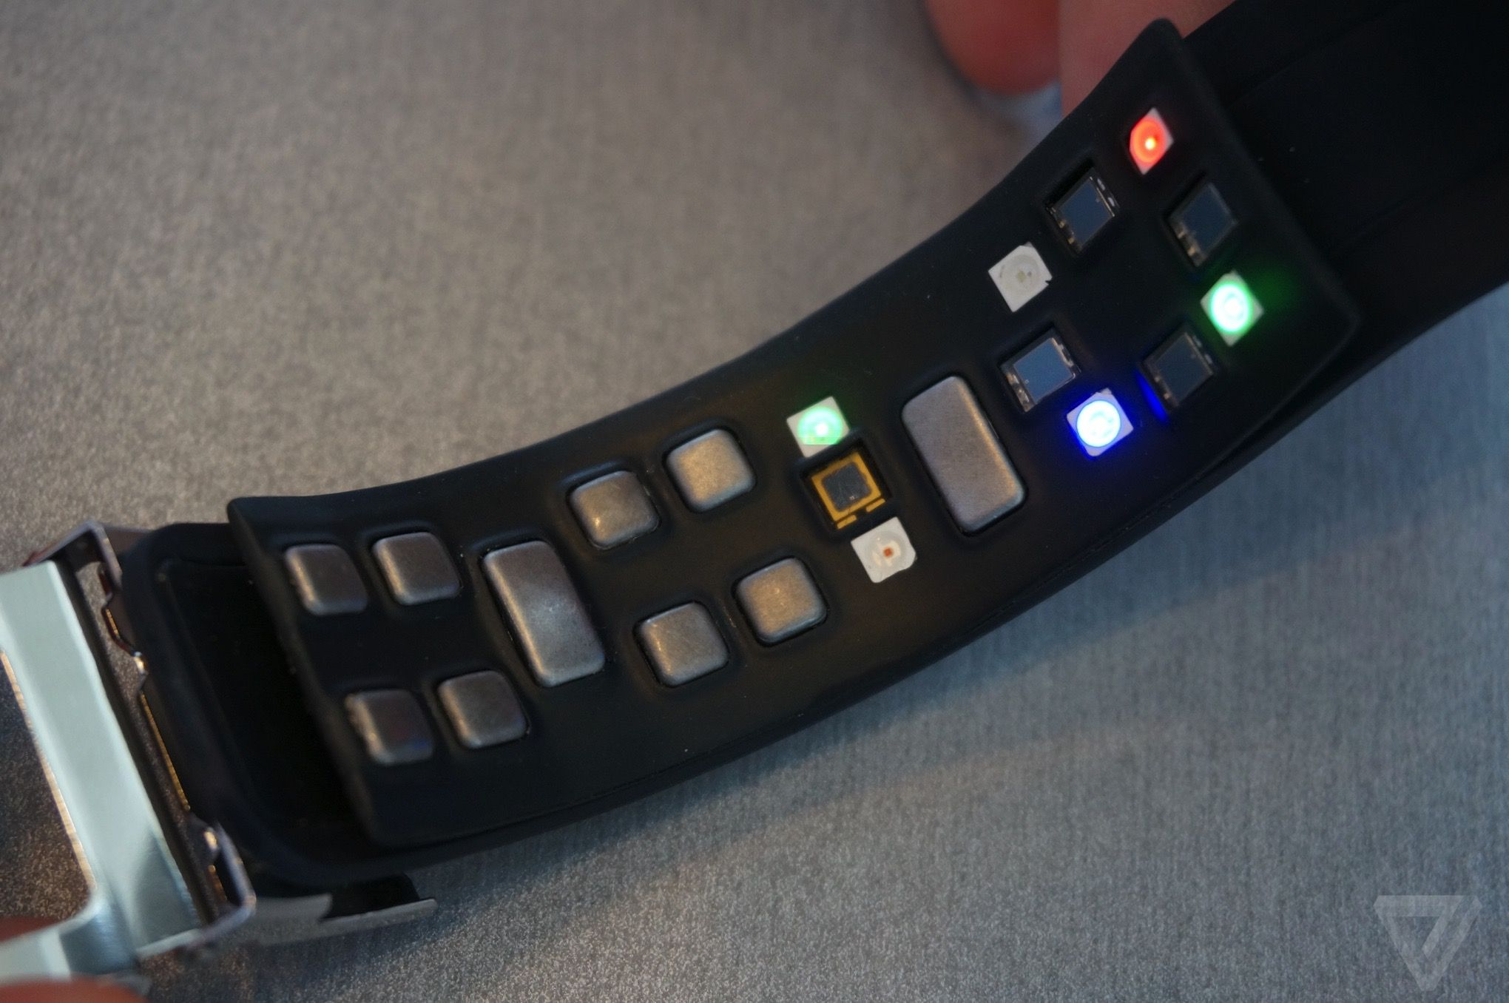
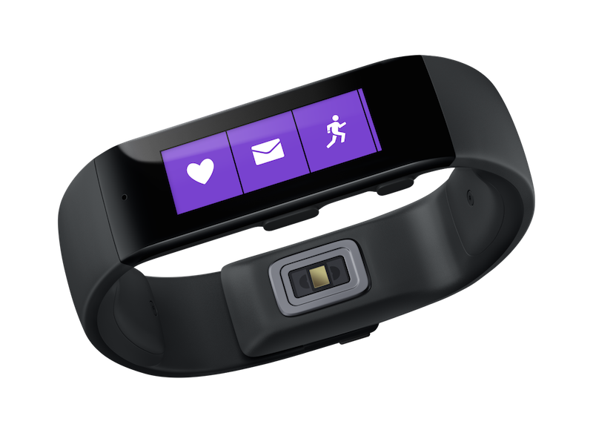
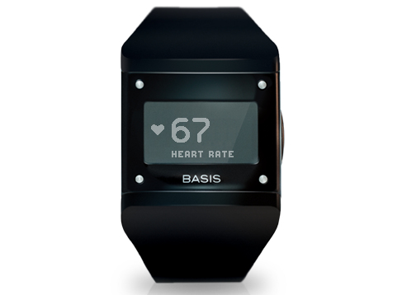
New smartwatches feature biometric sensors
APIs are generally lacking, data is locked in proprietary apps
Samsung Simband
Microsoft Band
BASIS Watch

Slide 10
Why measure cognitive load?
“You should take a break”
Automatic difficulty adjustment in applications (such as games)
People on the autism spectrum do display psychiological response, this can be used to predict ‘explosions’ of emotions
Classroom applications, are students following/getting it?

Slide 11
GSR
I decided measure the galvanic skin response,
Classify task difficulty from features of the GSR data

Slide 12
Experiment

Slide 13
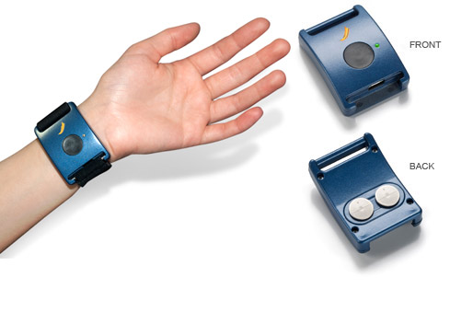
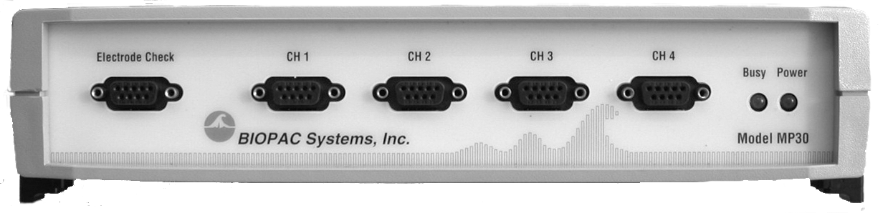
Apparatus
Affectiva Q Sensor (dry electrodes on wrist)
BIOPAC MP30
(wet finger electrodes)

Slide 14
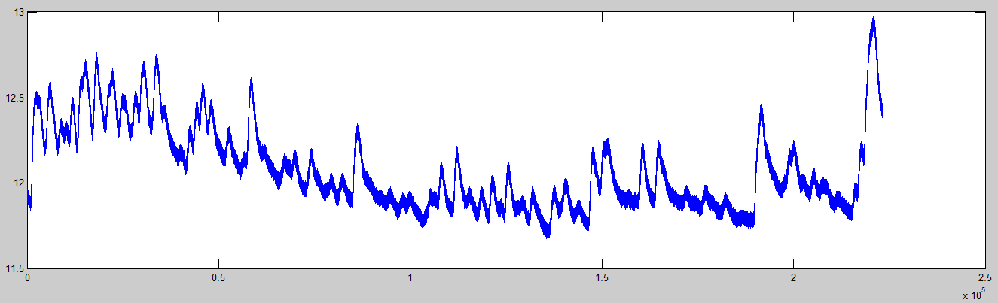
Raw data

Slide 15
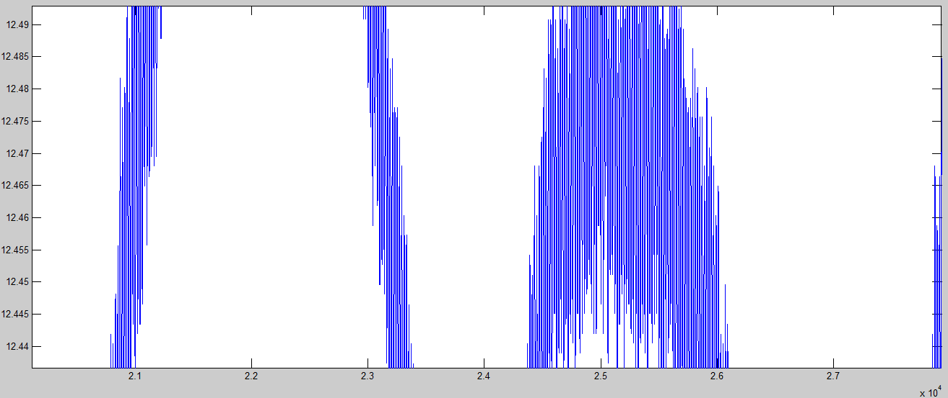
Raw data
DC current noise (50Hz) in signal

Slide 16
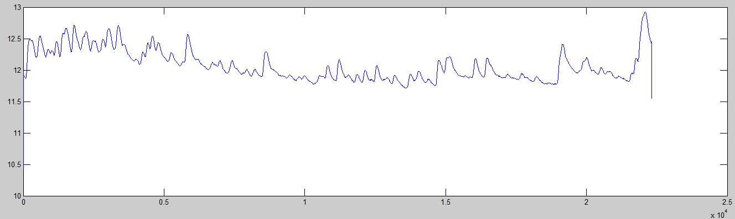
Preprocessing
Smoothing filter (removing DC current)
(Savitzky-Golay filtering)

Slide 17
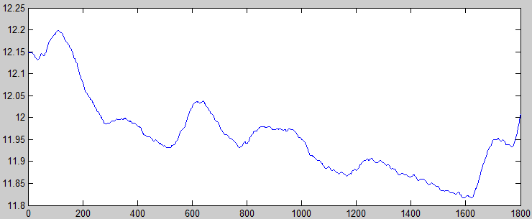
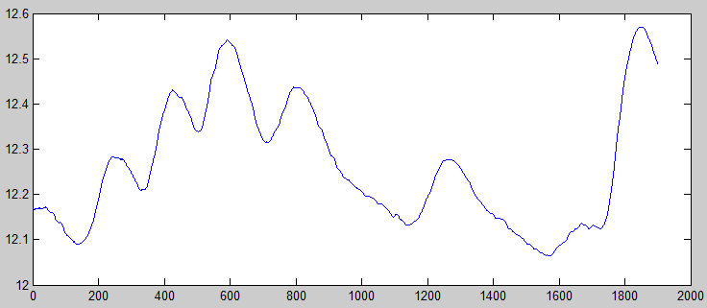
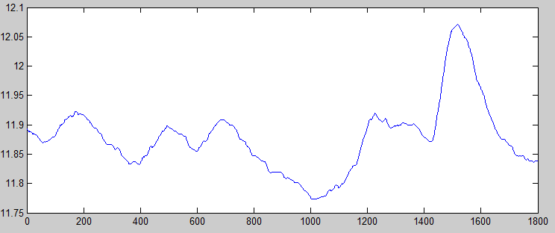
Preprocessing
Cutting the tasks out of the data
...

Slide 18
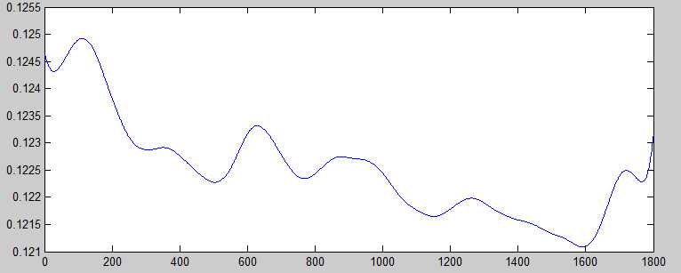
Final preprocessing
Normalizing (dividing by subject average GSR over all tasks)
Smoothing out small DC current spikes (Savitzky-Golay filtering)

Slide 19
Transformation
Extract time and frequency domain information
Export to WEKA readable format (CSV)
'luc' 'diff1' [220.5357] [0.1225]
(Name, Difficulty, accumulative GSR, Average GSR)

